Slide 1
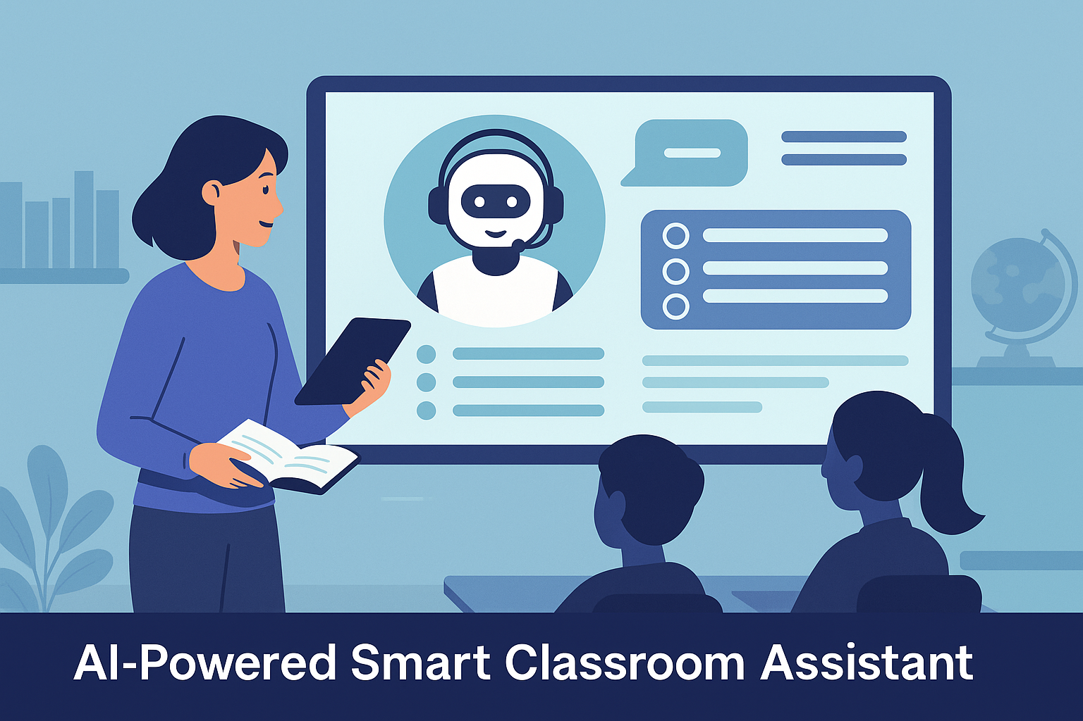

Slide 2
Intel Unnati Industrial Training program
AI-Powered Interactive Learning Assistant for Classrooms
By Team: Trishul
M. Vishnu Teja – BU22EECE0100461
Harshit Ramesh Hundia – BU22EECE0100442
Darshan. H – BU22EECE0100464

Slide 3
Problem Statement
AI-Powered Interactive Learning Assistant for Classrooms
Building a smart assistant that supports students and teachers during lessons by:
Answering student's questions instantly
Adapting explanations to student levels
Providing real-time quizzes of document
General Q&A session
Practice questions, Important questions, Summary of the document
This solution makes learning more engaging, personalized, and efficient using AI in classrooms.

Slide 4
Solutions and Features Offered
Our AI-powered learning assistant addresses core learning challenges by offering the following smart solutions:
📄 Contextual Question Answering
Upload notes (PDF, TXT, DOCX)
Uses local Flan-T5 model to answer queries from these documents with high accuracy
🌐 General Knowledge Q&A
Uses Gemini API + real-time web search for current facts & global queries
😃 Emotion Detection
Understands user mood from text input to improve empathy in responses
📝 Notes Summarization
Quickly summarizes long notes into key points using Gemini API
🎯 Quiz Generation
Automatically generates MCQs from study materials for practice
🔍 Important Points Extraction
Extracts most important questions & concepts for focused revision
🎙️ Voice-based Interaction (Console Utility)
Offers hands-free interaction via voice commands using Whisper + pyttsx3
⚡ Optimized AI Performance
Uses OpenVINO to accelerate AI model responses on Intel hardware

Slide 5
Technologies used
Language & UI: Python, Streamlit
AI/ML: Flan-T5, Emotion Classifier (Hugging Face), OpenVINO
Cloud Services: Google Gemini API, Custom Search API
Speech Processing: Whisper, sounddevice, pyttsx3
Document Parsing: pypdf, python-docx
Tools: Git, GitHub, VS Code

Slide 6
Challenges & solutions
Model Accuracy Challenge: Flan-T5 gave poor results for general queries Solution: Introduced Gemini API for broader/general Q&A
Session State in Streamlit Challenge: Data reset on app rerun Solution: Used st.session_state to persist data
Hybrid Model Routing Challenge: Choosing between local and cloud models Solution: Added logic to route based on query type and document context
Git Issues Challenge: Merge conflicts, author identity errors Solution: Resolved with proper Git config, pull before push, and manual conflict handling
Large Document Handling Challenge: Flan-T5 couldn't process large chunks of text Solution: Implemented intelligent text chunking and context filtering
API Key Security Challenge: Protecting sensitive API keys Solution: Used environment variables and secure Canvas configuration

Slide 7
Architecture
The solution uses a Hybrid AI Architecture combining:
Frontend (Streamlit Web UI)
User interface for file upload, input, and chat
Displays Q&A, summaries, quizzes, etc.
Backend (Python)
Manages logic, session state, model routing
Orchestrates interaction between local and cloud models
Local AI Models (via OpenVINO)
Flan-T5: Contextual Q&A from uploaded documents
Emotion Classifier: Understands user sentiment
Whisper: Speech-to-text for voice input (console utility)
Cloud Services (via Gemini API)
General knowledge Q&A
Summarization, quiz generation, key points extraction
Real-time web search via Google Custom Search
Document Parsing
Supports TXT, PDF, DOCX
Custom chunking for relevant context extraction

Slide 8
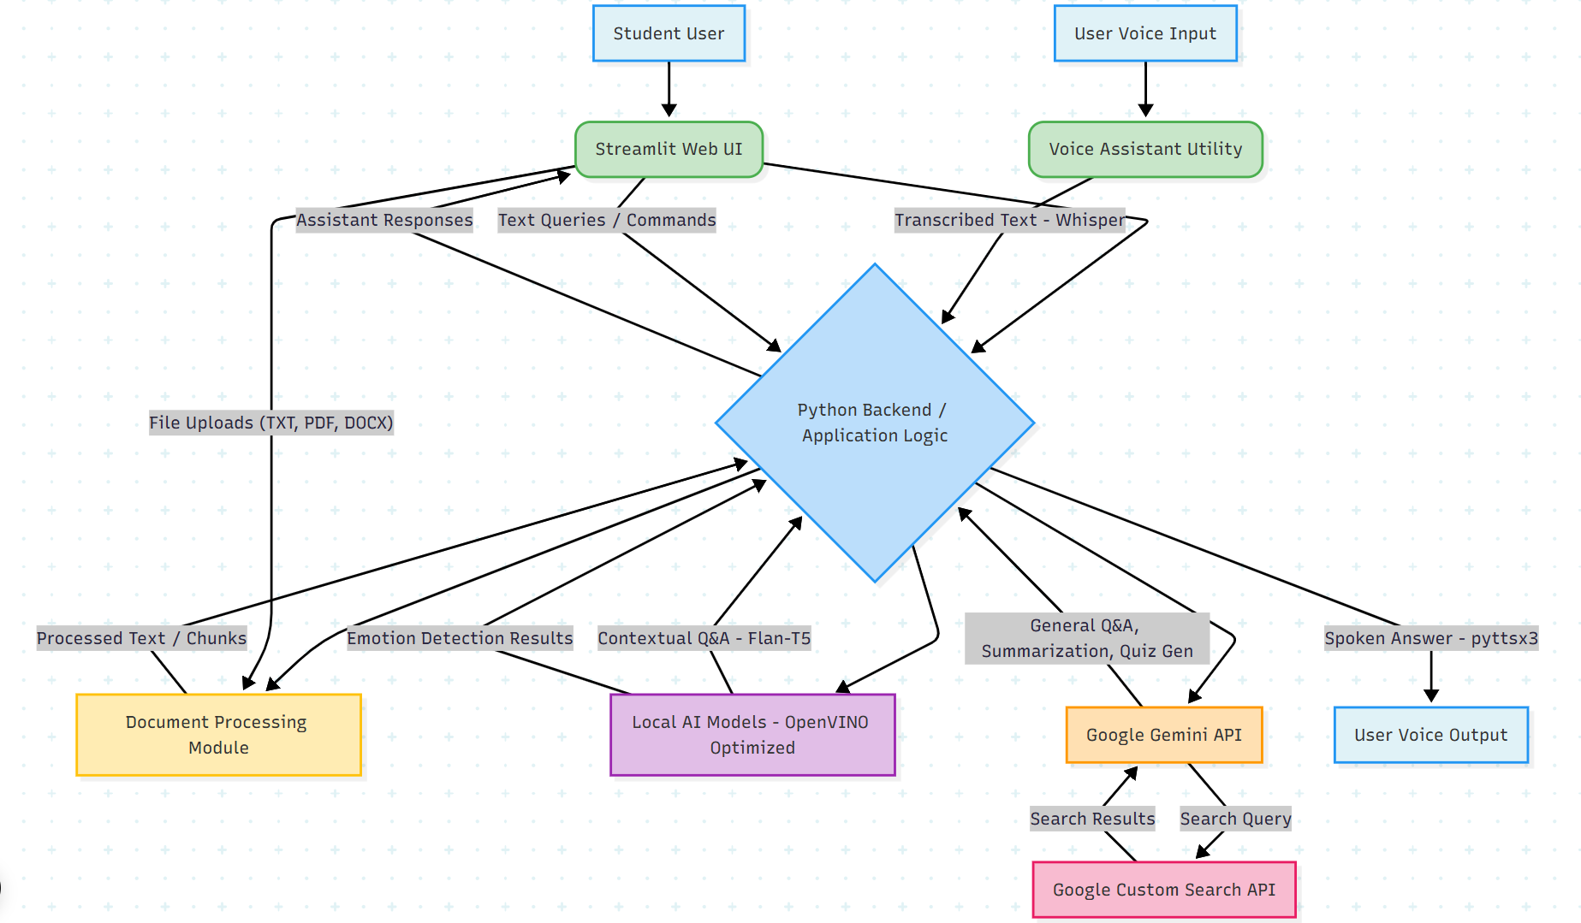

Slide 9
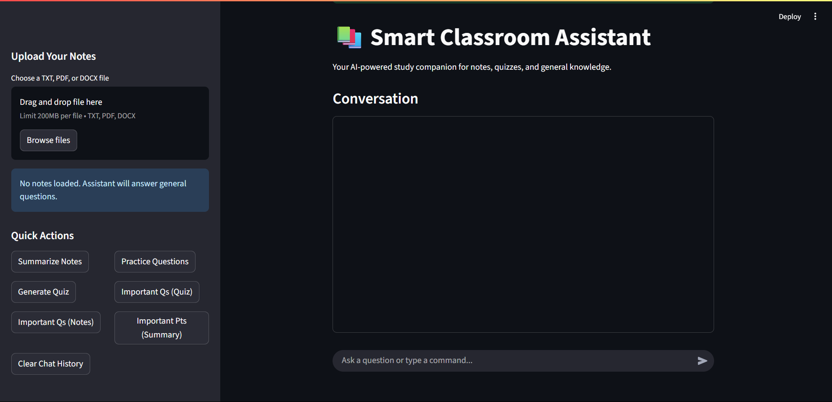
Interface of the Project

Slide 10
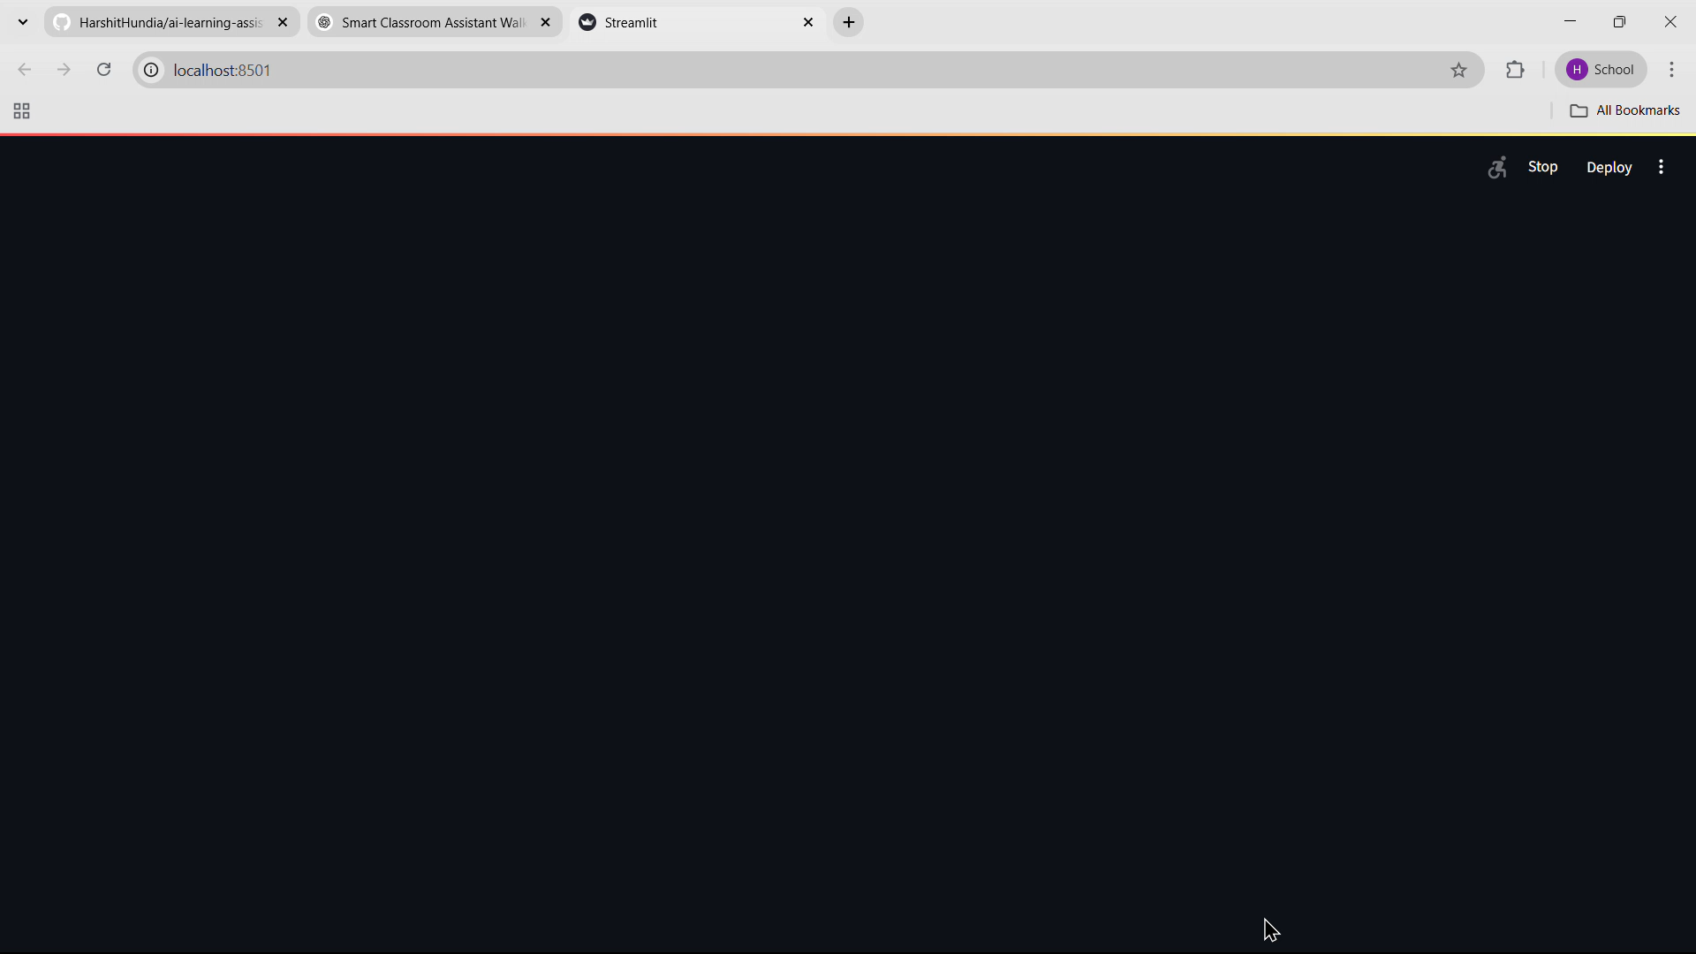
Video

Slide 11
Future enhancements
Voice Integration in Web UI Enable live voice input in the Streamlit interface (replacing console utility).
Personalized Learning Suggest study paths based on quiz performance and interaction history.
Interactive Quizzes Allow students to take quizzes within the web app with instant feedback.
Mobile & Multilingual Support Optimize for mobile use and add support for regional languages.
User Accounts & Profiles Enable login, save notes, quiz results, and chat history.
LMS Integration Sync with platforms like Google Classroom and Moodle.
Image Input & Recognition Accept handwritten or image-based notes for processing.
Smart Attendance Tracking Use voice or face recognition for marking attendance.

Slide 12
Conclusion
The Smart Classroom Assistant is a practical demonstration of how AI can transform classroom learning. By integrating local models (for privacy and speed) with cloud-based services (for broader knowledge and generative tasks), it provides students with personalized, efficient tools like contextual Q&A, quiz generation, and summarization. This hybrid approach not only enhances engagement and understanding but also lays a solid foundation for future innovations in AI-powered education platforms.

